Slide 1

Capstone Project-2
Seoul Bike Sharing Demand Prediction (Supervised Machine Learning Regression )
By: Gyanveer Meena

Slide 2
Content
Problem Statement
Data Summary
Feature Summary
Insight of Dataset
EDA
Data Processing
Model Building
Challenges
Conclusion

Slide 3
Problem Statement:
Currently Rental bikes are introduced in many urban cities for the
enhancement of mobility comfort. It is important to make the rental bike
available and accessible to the public at the right time as it lessens the
waiting time. Eventually, providing the city with a stable supply of rental
bikes becomes a major concern. The crucial part is the prediction of bike
count required at each hour for the stable supply of rental bikes

Slide 4
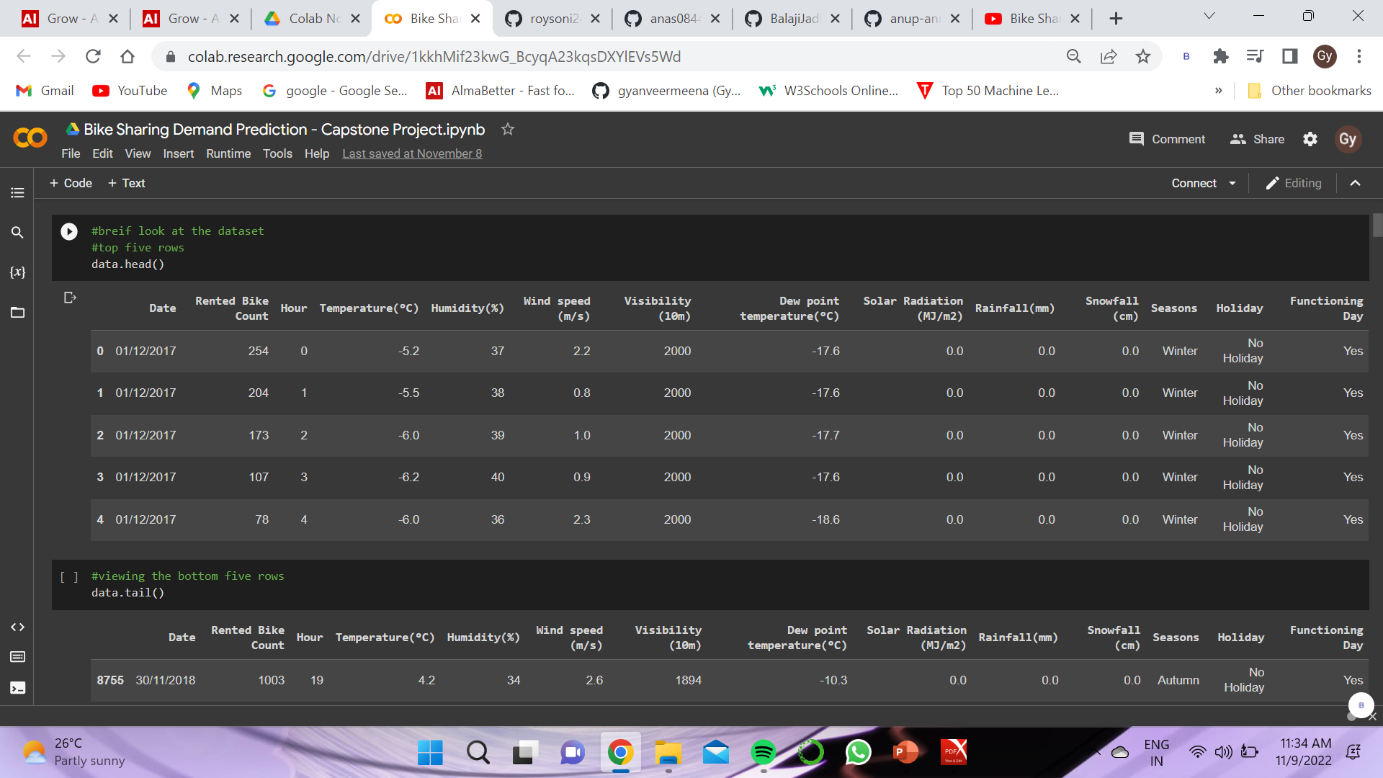
Data Summary
This Dataset contains 8760 lines and 14 columns.
Three categorical features ‘Seasons’, ‘Holiday’, & ‘Functioning Day’.
One Datetime features ‘Date’.
We have some numerical type variables such as temperature, humidity, wind,
visibility, dew point temp, solar radiation, rainfall, snowfall which tells the
environment conditions at that particular hour of the day.

Slide 5
Feature Summary
Date : Year-Month-Day
Rented Bike Count - Count of bikes rented at each hour
Hour - Hour of the day
Temperature - Temperature in Celsius
Humidity - %
Wind Speed - m/s
Visibility - 10m
Dew point temperature -Celsius
Solar radiation -MJ/m2
Rainfall -mm
Snowfall -cm
Seasons -Winter, Spring, Summer, Autumn
Holiday -Holiday/No Holiday
Functional Day - NoFunc(Non Functional Hrs),Fun(Functional Hrs)

Slide 6
Insight of our data:
There are No Missing Values present.
There are No Duplicate values present.
There are No null values.
And finally we have 'rented bike count' variable which we need to predict for new observations.
The dataset shows hourly rental data for one year (1 December 2017 to 31
November(2018)(365 days),we consider this as a single year data.
So I convert the "date" column into 3 different column i.e. "year", "month", “day” and and drop the date column Because we don’t need that.
I have changed the few of our features name because they were not written properly, the name are follows:
“Rented_Bike_Count” , “Temperature”, “Humidity”, “Wind_speed”, “Visibility”, “Dew_point_temperature”, “Solar_Radiation”, “Rainfall”, “Snowfall”, “Functioning_Day”

Slide 7
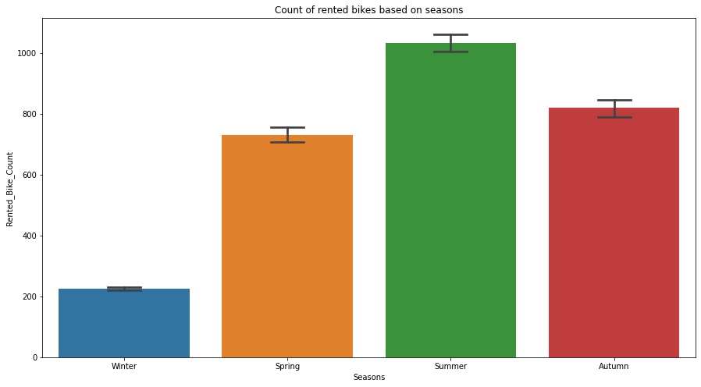
EDA
Analysis of Season Variable by visualization
From the graph plotted on the side, we can clearly see that the rented bike counts are higher in Summer season. The difference between Autumn and Spring is not that much. Bike counts are very low in Winters, means people avoid using rented bike in winter due to the low temperature.

Slide 8
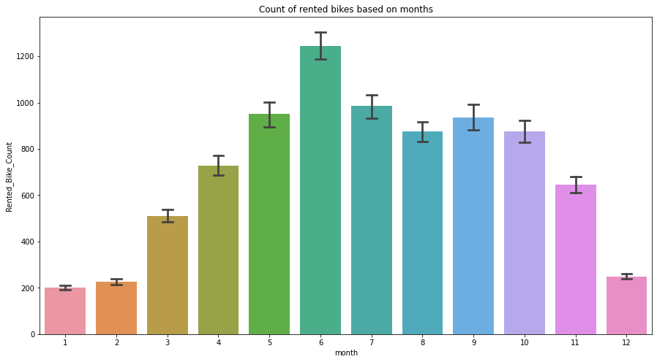
Analysis of Month Variable by visualization
As we can see clearly in the graph plotted on the side ,from the month 5(may) to 10(Oct) the demand of the rented bikes are high as compare to other months and these are the month of Summer season.

Slide 9
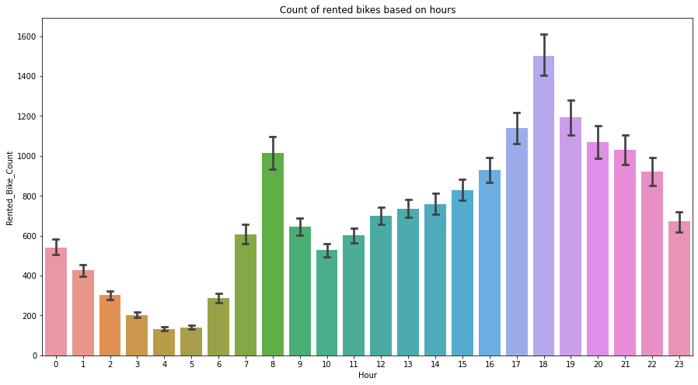
Analysis of Hour Variable by visualization
The above graph shows the rented bike counts based on the hour of the day. Showing the hours in which people use more rented bikes.
As we can see generally people use rented bikes around 7am to 9am in office hour rush and 5pm to 8pm.

Slide 10
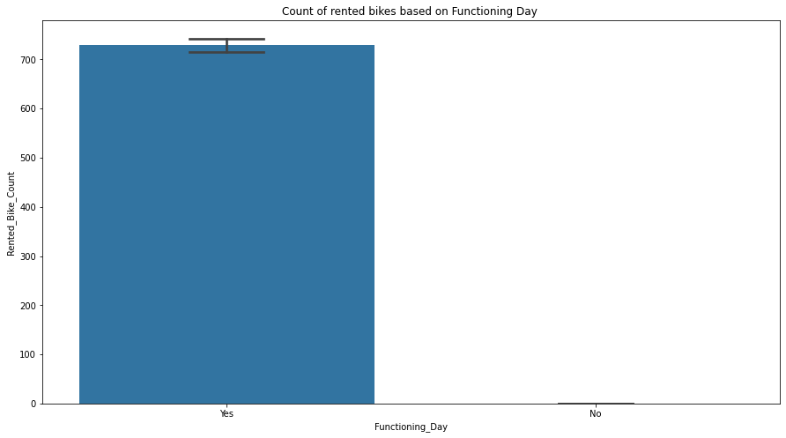
Analysis of Functioning day Variable by visualization
The graph on the side shows the use of rented bikes on functioning day or non-functioning day, and it clearly shows that people don’t use rented bikes on no-functioning day, they use bikes on functioning days.

Slide 11
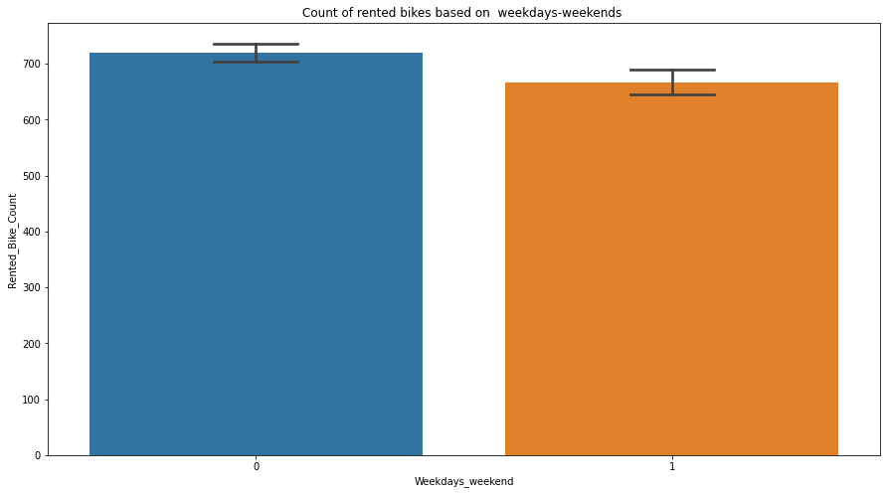
Analysis of Weekdays and Weekends Variable by visualization
The graph on the side shows the rented bike counts on weekdays and weekends and we can say that by looking at the graph demand is high on weekdays (shown in the bule) than on weekends (shown in the orange).

Slide 12
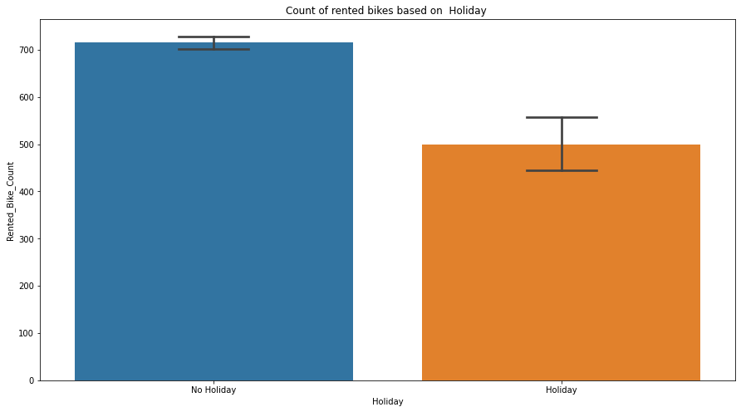
Analysis of Holiday Variable by visualization
As the graph shows plotted on the side that people rented bikes more when there is no holiday because people use rented bike mostly for offices, that’s why demand is high when there is no holiday.

Slide 13
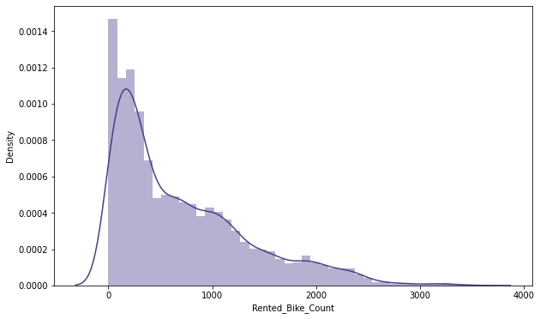
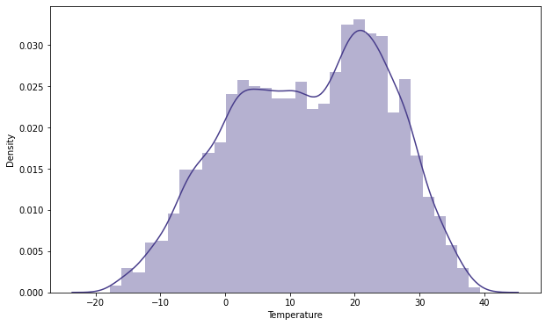
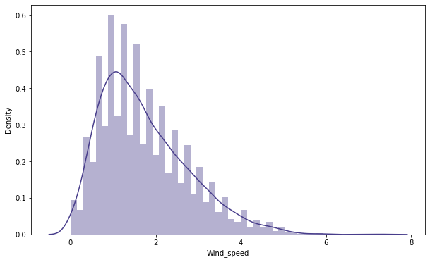
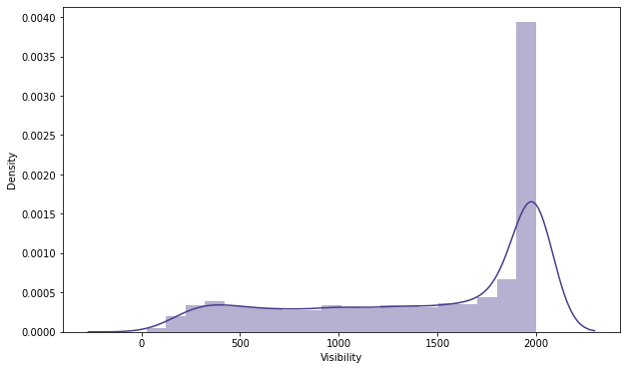
Visualizing Distributions

Slide 14
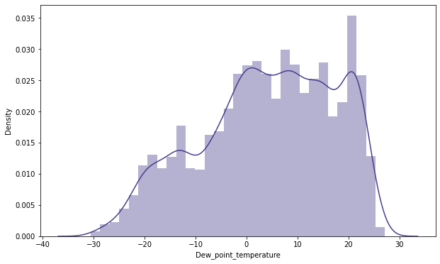
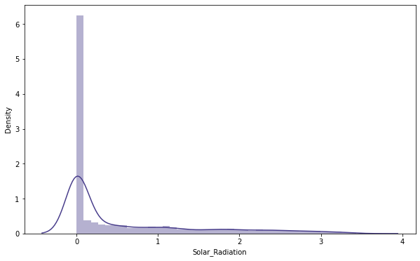
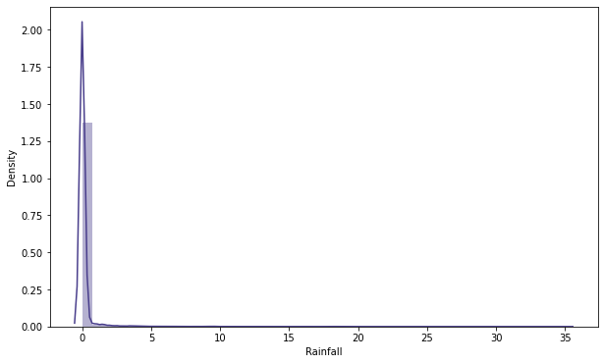
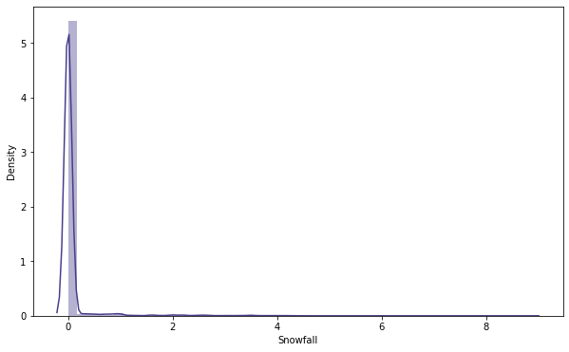
Visualizing Distributions

Slide 15
Visualizing Distributions Observation
Rented_Bike_Count, Solar_Radiation, Rainfall, Snowfall shows the
highly right skewed distribution and Wind speed shows the slightly right
skewed distribution.
Visibility shows the highly left skewed distribution.
Temperature, Humudity, and Dew point temperature shows close to
normally distributed.

Slide 16
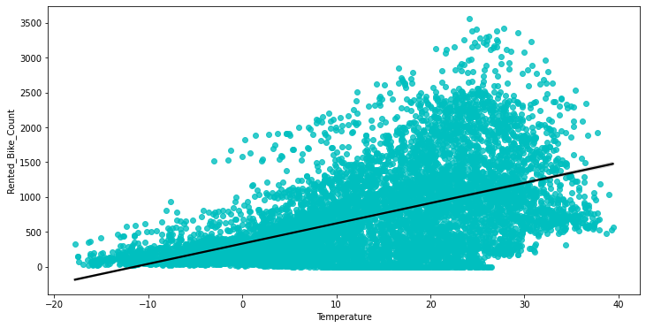
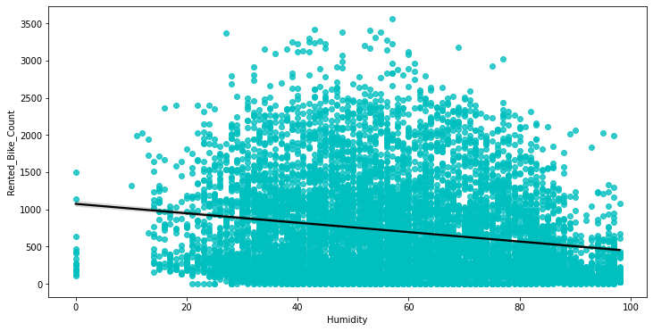
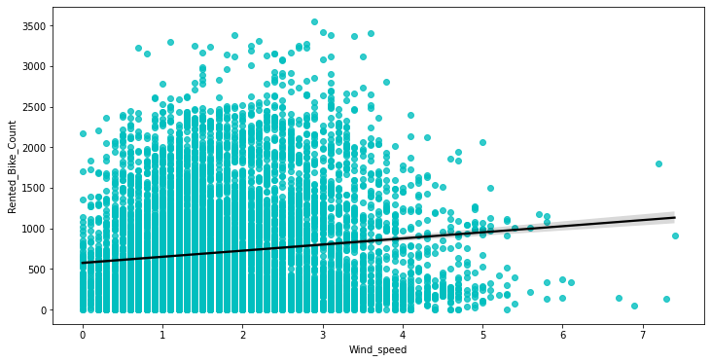
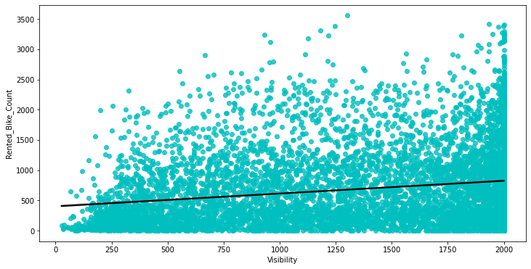
Regression Plot for Numerical Variables

Slide 17
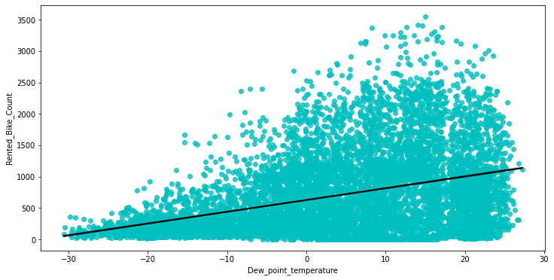
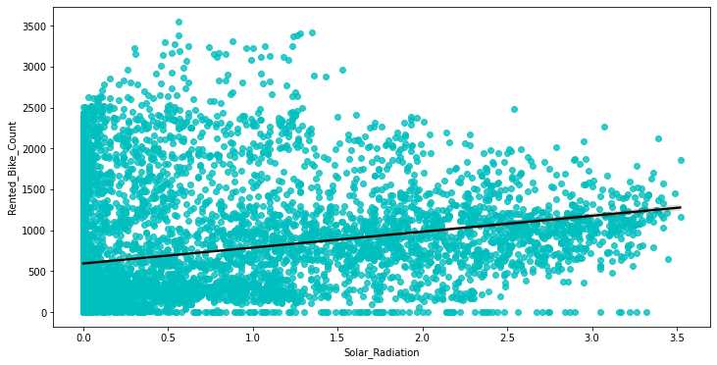
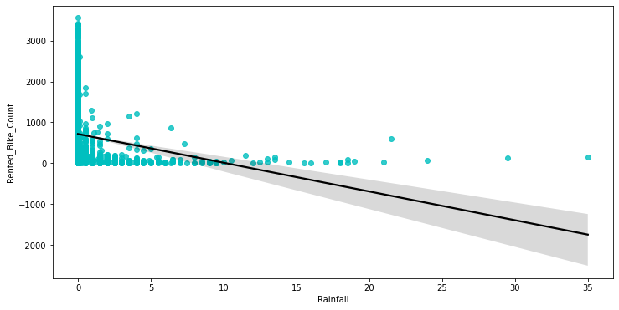
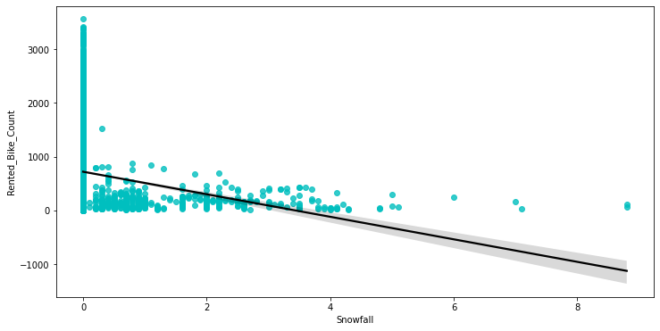
Regression Plot for Numerical Variables

Slide 18
Observation from Regression Plot for Numerical Variables
Effects of Numerical features in rented bike count
Temperature: Temperature graph shows positive relation and as shown in the graph people use more rented bikes between 20 °C and 30 °C. So temperature has an effect.
Humidity: Humidity is the amount of water in the air and as we can see people use less number of bikes when humidity is high that shows negative relation.
Wind speed: As we can see in the graph wind speed doesn't affect our data that much.
Visibility: visibility doesn't affect our data much but in the graph we can see it is positively related with bike count.
Dew point temperature: The dew point is the temperature to which air must be cooled to become saturated with water vapor, assuming constant air pressure and water content. It shows almost same relation as the temperature that is positive.
Solar Radiation: As the graph shows it has positive relation with the bike count.
Snowfall and Rainfall: As we can see both graph shows almost same relation that is negative. People avoid rented bikes when its raining and showing.

Slide 19
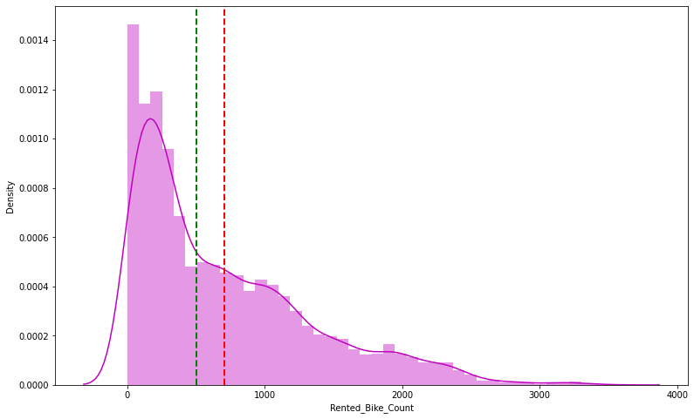
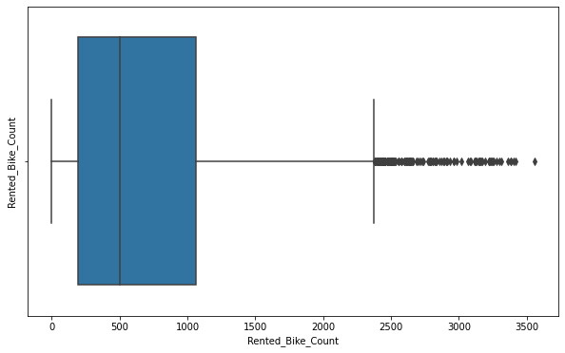
Normalization of Rented Bike Counts
The above graph shows that Rented Bike Count has highly right skewness.
The above boxplot shows that we have detect outliers in Rented Bike Count column.
Since the assumption of linear regression is that 'the distribution of dependent variable has to be normal', so we are perform Square root operation to make it normal.

Slide 20
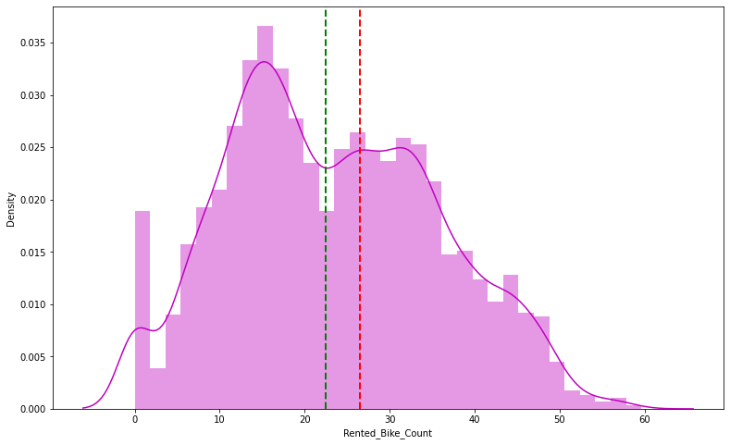
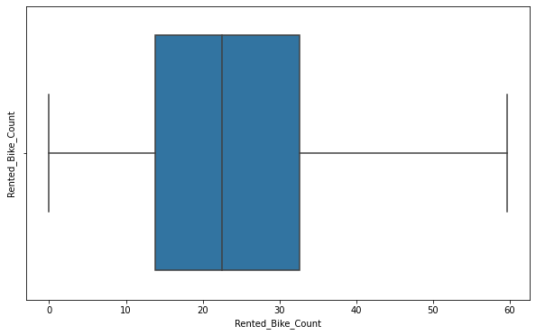
Normalization of Rented Bike Counts
After applying Square root to the skewed Rented Bike Count, here we get almost normal
distribution.
After applying Square root to the Rented Bike Count column, we find that there is no
outliers present now.

Slide 21
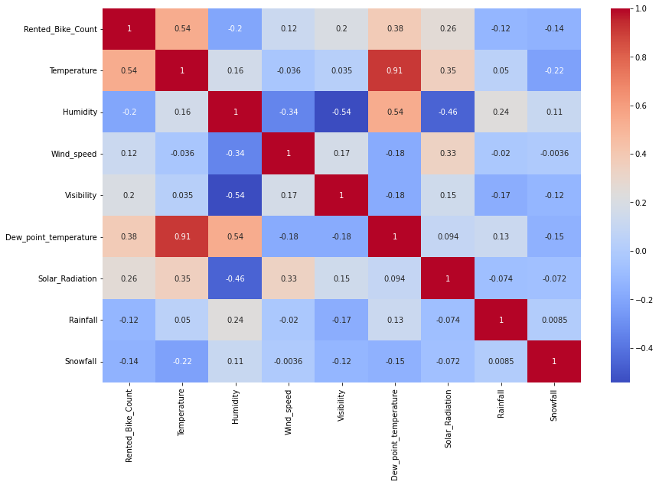
Correlation Between variables
From the correlation heatmap graph on the right hand side we get to know that some feature are positively correlated with dependent variable and some are negatively correlated.
As we can see there is a highly positive correlation between Temperature and Dew point temperature i.e 0.91 so even if we drop the dew point temperature it don't affect our analysis.

Slide 22

Model Building
Model we are going to use for our analysis are as follows:
Linear regression model
Lasso regression model
Ridge regression model
Elastic net regression model
Decision tree regression model
Random-forest regression model
Gradient Boosting Regression model

Slide 23
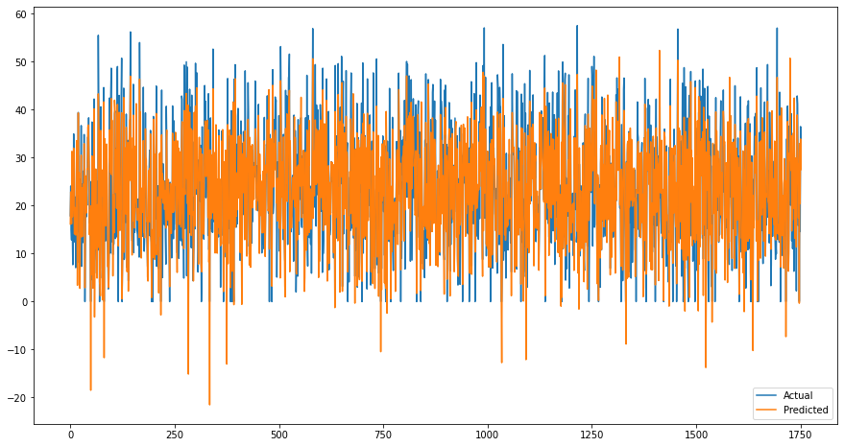
Linear Regression
Train Set Results
Test Set Results
MSE: 34.793980690219946
RMSE: 5.898642275152812
MAE: 4.459079727099164 r2_score: 0.774552733127227
MSE: 33.894124066686764
RMSE: 5.821866029606553
MAE: 4.442357194447212
r2_score: 0.774552733127227

Slide 24


Lasso Regression (L1)
Ridge Regression (L2)
Train Set Results
Test Set Results
Train Set Results
Test Set Results
MSE: 34.79515728315087
RMSE: 5.898742008526129
MAE: 4.459189222397434
r2_score: 0.774545109404
MSE: 33.89836655012501
RMSE: 5.822230375906214
MAE: 4.442795226993453 r2_score: 0.784753494319
MSE: 34.794981668998176
RMSE: 5.898727122778115
MAE: 4.460155759028087
r2_score: 0.7745462472947
MSE: 33.90911270892113 RMSE: 5.82315315863503 MAE: 4.444572516142195 r2_score: 0.78468525878

Slide 25

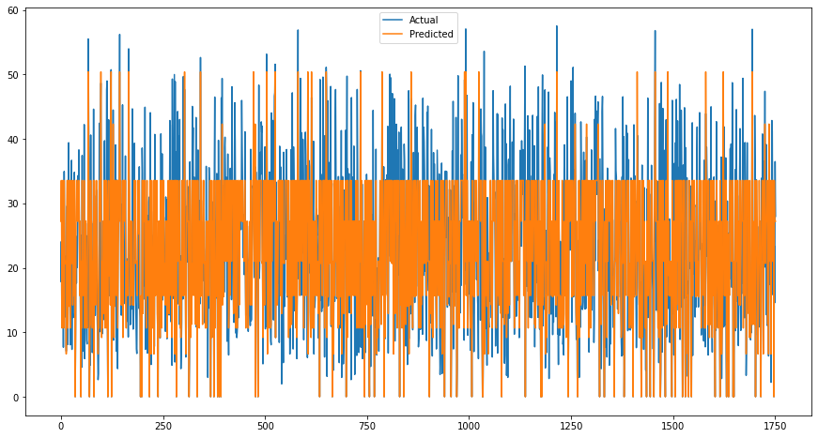
Elastic Net Regression
Decision Tree Regression
Train Set Results
Test Set Results
Train Set Results
Test Set Results
MSE: 34.794243479945166
RMSE: 5.898664550552537
MAE: 4.459595603494476 r2_score: 0.77455103038
MSE: 33.9015667437918
RMSE: 5.822505194827378 MAE: 4.443480979562117 r2_score: 0.784733173856
MSE: 53.531090009620016 RMSE: 7.316494379798294 MAE: 5.5385784606806245 r2_score 0.653145811546
MSE: 58.6535674359265 RMSE: 7.658561708044566 MAE: 5.694736873070751 r2_score: 0.627563899941

Slide 26
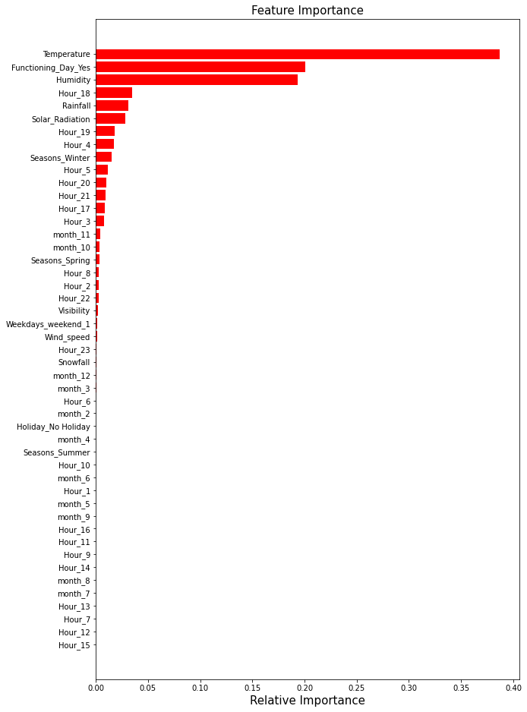
Random Forest Regression
Train Set Results
MSE: 32.62524954401073
RMSE: 5.711851673845421
MAE: 4.31210510752619
r2_score 0.7886050059570546
Test Set Results
MSE: 36.445334196704664
RMSE: 6.036997117500112
MAE: 4.471939927945458
r2_score: 0.768580860007089

Slide 27
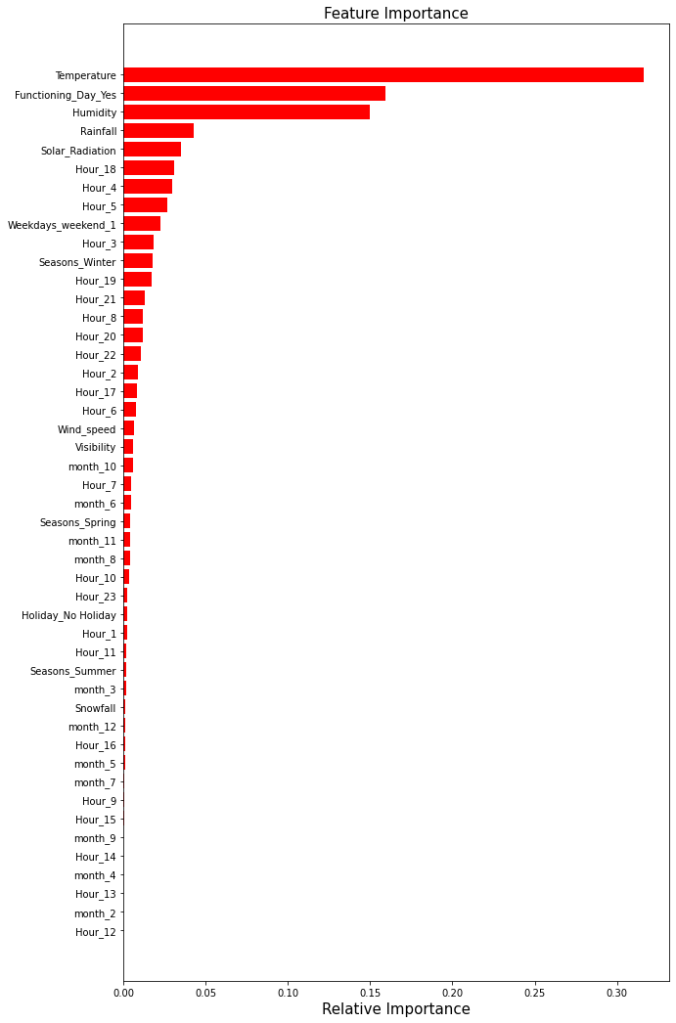
Gradient Boosting Regression
Train Set Results
SE: 7.505807191023706
RMSE: 2.739672825543902
MAE: 1.8631365411283434
r2_score 0.9513661937116054
Test Set Results
MSE: 12.30420561257403
RMSE: 3.5077351115176914
MAE: 2.3703535351531975 r2_score: 0.9218712423985597

Slide 28
Challenges
Large Dataset to handle.
Needs to plot lot of Graphs to analyze.
Feature engineering
Feature selection
Optimizing the model
Carefully tuned Hyperparameters as it affects the R2 score.

Slide 29
Conclusion:
The dataset is about rented bike count in urban area, given different variables affecting the demand of rented bikes.
Rented bike counts according to the seasons, Summer have the highest number and than Autumn and Spring and least numbers of rented bike are in Winters.
There was sharp increase in demand from the end of 2017 that too in winter season of the year. The demand however decrease at the end of 2018, highest count was from 5 (May) to 10 (October).
People use rented bike more from 7am to 9am and 5pm to 9pm in a day.
Rented bike counts are higher on Functioning Days.
The difference between rented bike count on weekdays and weekends have not much difference but weekdays have little more counts.
People use rented bike when there is No Holiday, maybe because of office.
Bike counts are highly positively correlated with Temperature and Hours

Slide 30
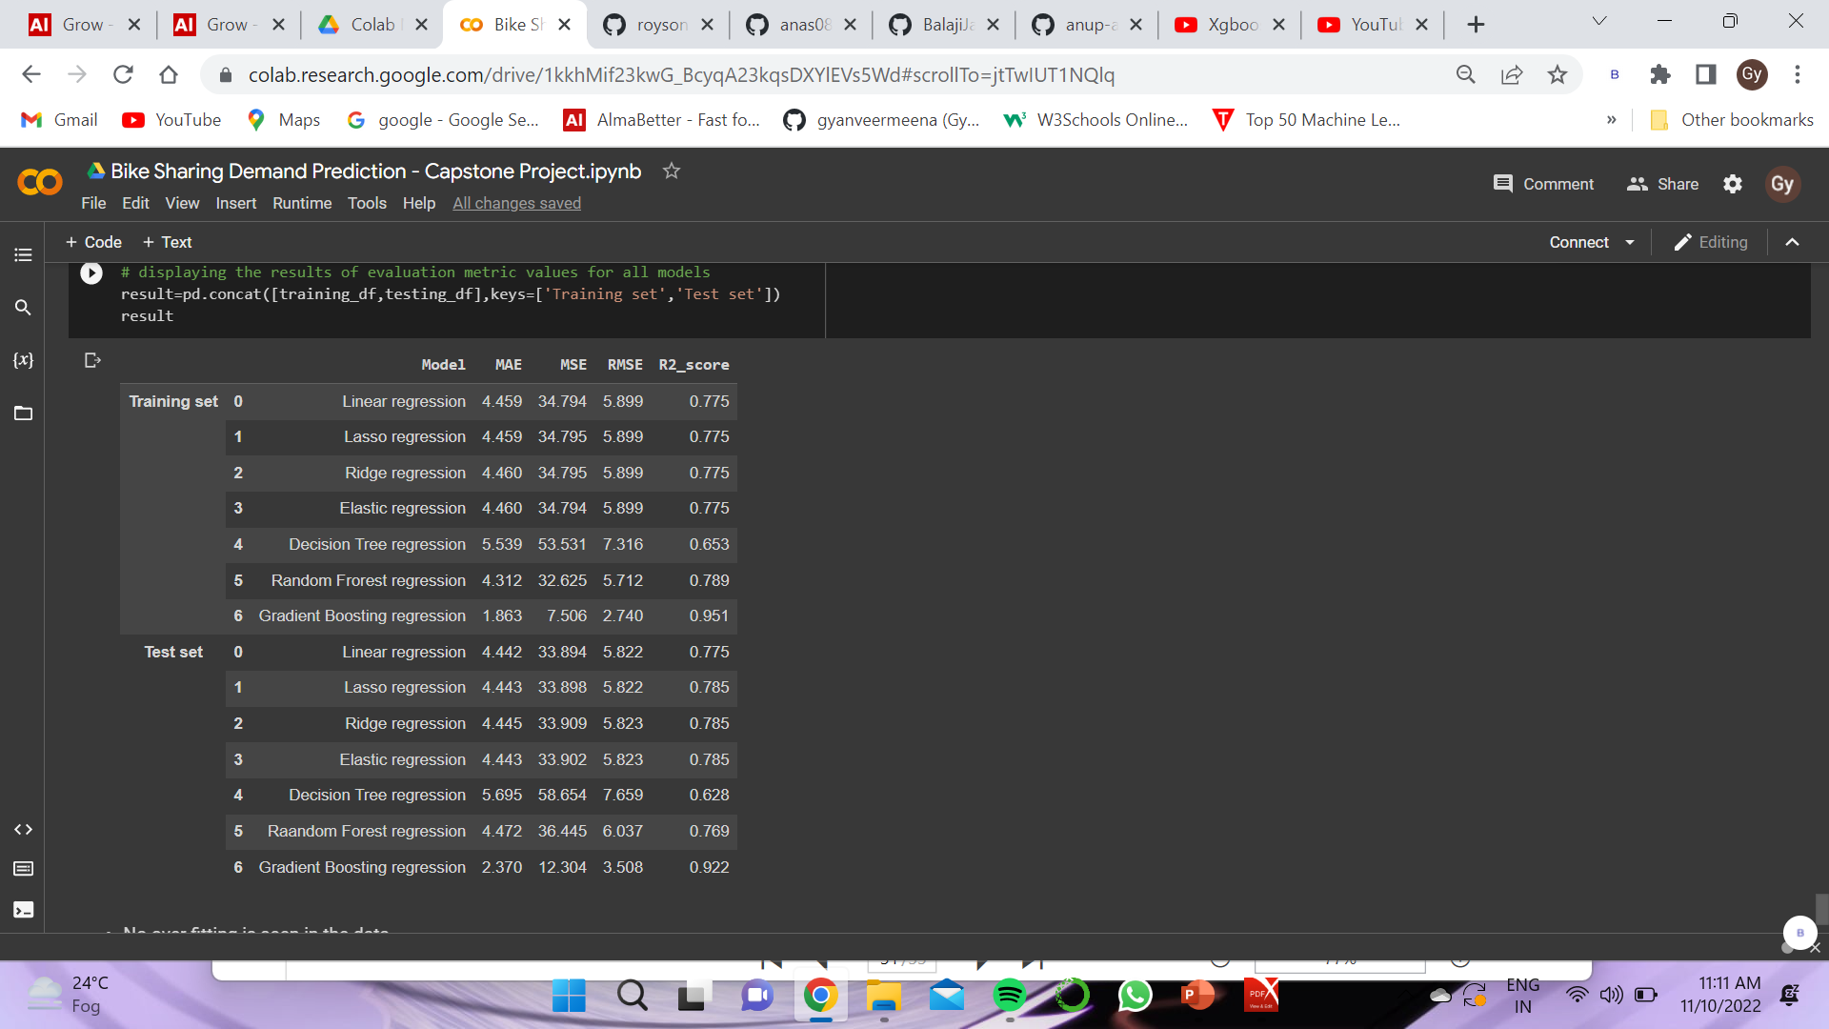
Conclusion:
Table on the right hand side shows the comparison of the all model have been used in the analysis.
When we compare the root mean squared error and mean absolute error of all the models, Gradient Boosting Regression gives the highest R2_scor of 95% and 92% respectively for Train and Test set. So finally this model is best for predicting the Rental Bike Counts.

Slide 31
Q & A

Slide 32
Thank You

